Slide 1

Sub Advisor Questionnaire – SAQ
2011 Release
Presented by
AMAS L3 Team

Slide 2
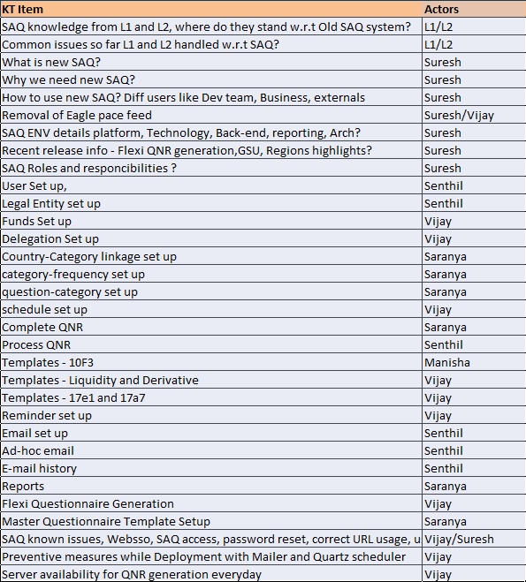
Agenda

Slide 3
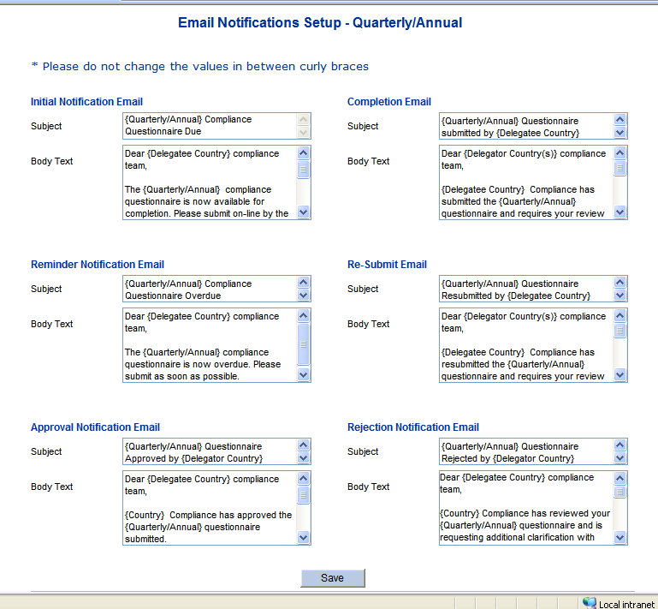
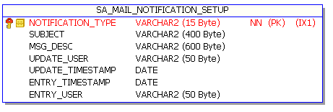
E-mail setup
The text for the automated emails can be updated through the Email Notification – Quarterly/Annual screen. The text other than curly braces can be modified.

Slide 4
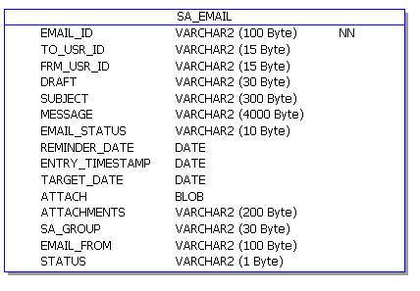
Ad-hoc Email
This functionality will be used in the event Compliance needs to send an Ad-hoc email to all sub-advisors, all sub-advisors within a group or to an individual sub-advisor.
The SAQ application will save the email sent and date sent. It will also store the name of the person who sent the email.
The ad-hoc email status/history can be tracked from the e-mail history screen.
Attachments
Save draft option

Slide 5
E-mail History
Compliance has the option of reviewing all emails sent to sub-advisors by using the Email History screen.
Click on the Email History link from the left menu to bring up the Email History screen.
Enter the search criteria and click on the Search button. All automated and ad-hoc emails matching the criteria will be displayed.

Slide 6
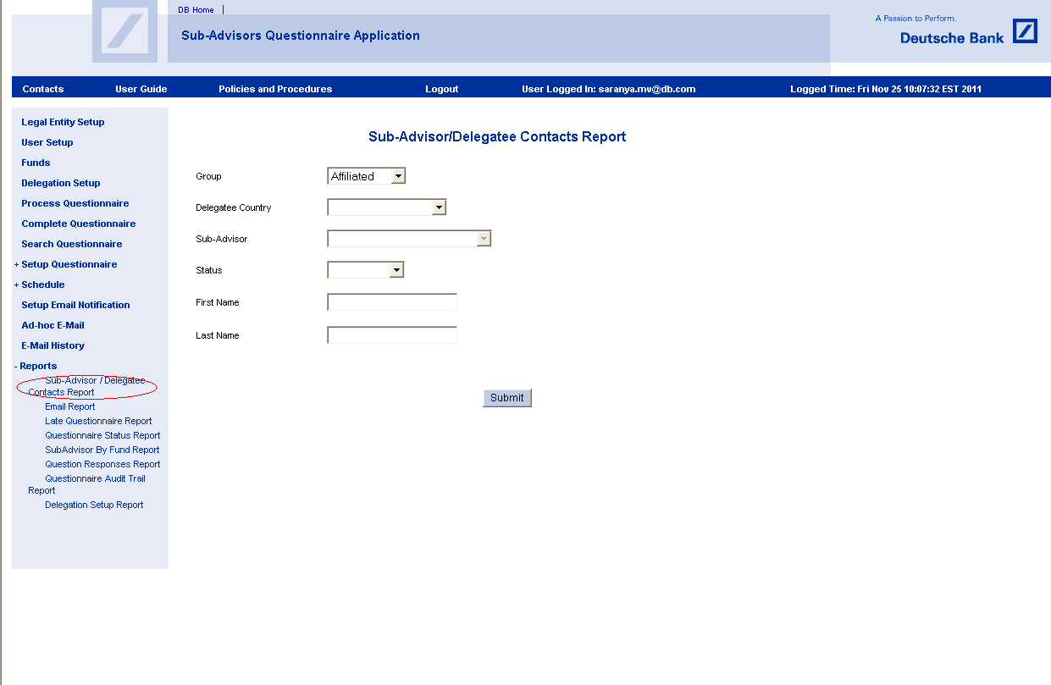
Reports
There are 8 reports available in SAQ system.
The reporting platform for the SAQ application is Actuate.
Report outputs are available in either PDF or Excel format.

Slide 7
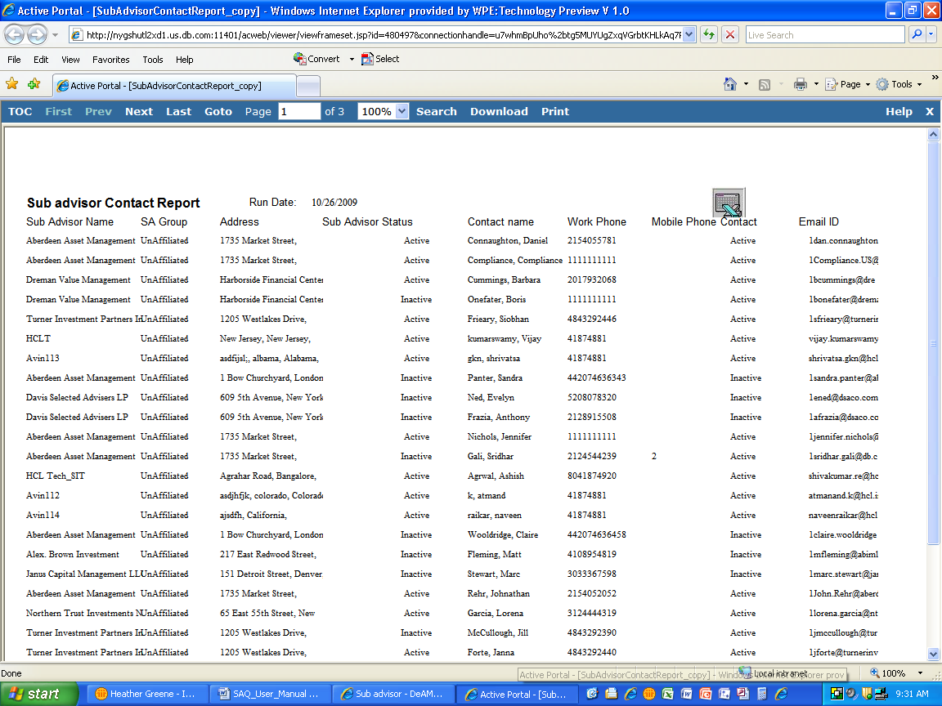
Reports (Contd.)

Slide 8
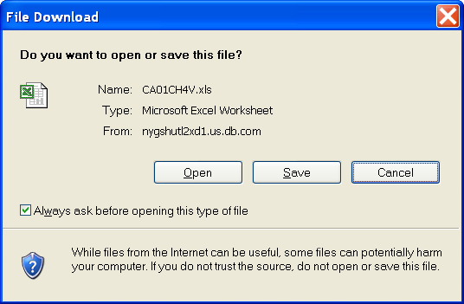
Reports (Contd.)

Slide 9
SAQ known issues
WebSSO Related
SAQ access
Password reset
Correct URL usage
User roles & SAQ login page
Queries/Info related
Except 10F3 Template rest can not be completed by GSU
How set up Questionnaire?

Slide 10
PRD Deployment
Uncommented versions of Mail sender/Email sender classes are deployed to live servers only
Commented versions of Mail sender/Email sender classes are deployed to PRD Staging servers
Uncommented version of Quartz scheduler class will be deployed to PRD Staging server only
Commented version of Quartz scheduler class will be deployed to live servers only
While Go-Live these has to be provided by L3

Slide 11
Server availability - PRD Staging node
PRD support team has to login to PRD SAQ system on a daily basis to check schedule set up screen to verify Questionnaire generation schedule for that day
PRD Staging node will automatically become unavailable after seven days of non-usage
PRD support team has to ensure server availability for questionnaire generation everyday 5AM EST
Fail cases have huge escalations and it need code fixes to generate.

Slide 12


Slide 13


